Slide 1
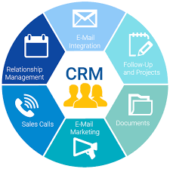
Customer Relationship Management
Done By :
M. LINGESH (211519205086)
D. MANOJ (211519205093)
V. LOKESHWARAN (211519205088)

Slide 2
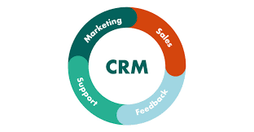
What is CRM?
Customer relationship management is a process in which a business or other organization administers its interactions with customers, typically using data analysis to study large amounts of information.
It is a software system that helps business owners easily track all communications and nurture relationships with their leads and clients. A CRM replaces the multitude of spreadsheets, databases and apps that many businesses patch together to track client data.

Slide 3
Abstract
This is a project to develop a Customer Relationship Management (CRM) system. CRM is one of the systems included in Enterprise Resource Planning (ERP) System. The main purpose of CRM is to improve the relationship with the customers by using different module like analysis, customer service and others.
The objective to do this project is to develop a system which can help the organizations to decrease their defection rate of customers. Because the lower defection rate means the bigger customer base, which lead to more profit for the organization.
CRM in this project is included few modules. The modules included are customer filtering, customer profiling and promotion tools. Customer filtering allows the user filter out a customer list from the customer database by using customer’s demographic information. Customer profiling to makes each customer is having a profile; the user may see the customer’s profile included analysis of customer. Promotion Tools allows the user can create new promotion base on the product, and filter list of customer to promote the promotion.

Slide 4
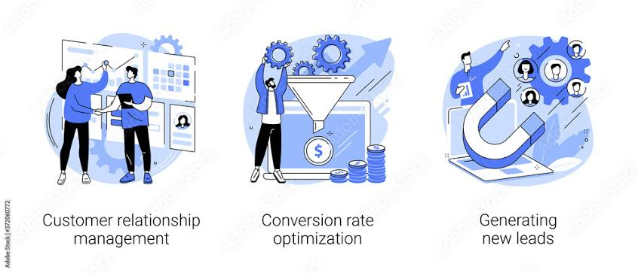
After that, the user can see the analysis of the performance of the promotion. The tools used to develop this CRM included PHP, Web server, Mysql, javascript, HTML, CSS, jquery and jquery’s plugin.
Customer relationship management (CRM) is a combination of people, processes, and technology that seeks to provide understanding of customer needs, to support a business strategy, and to build long-term relationships with customers

Slide 5
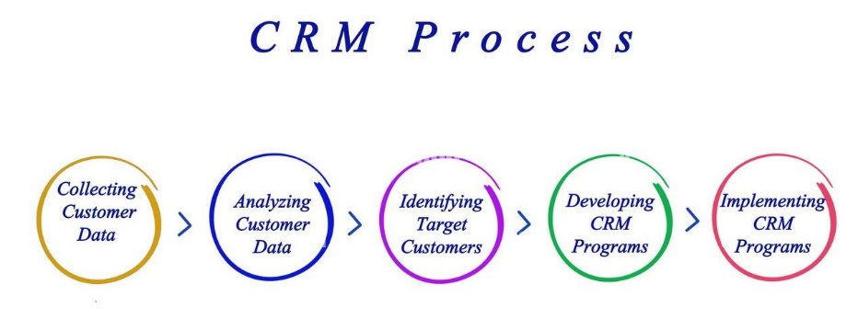
How does CRM works/Process
There are three main types of CRM systems: collaborative, analytical, and operational . CRM stands for “Customer Relationship Management” and is a software system that helps business owners easily track all communications and nurture relationships with their leads and clients.
A CRM replaces the multitude of spreadsheets , databases and apps that many businesses patch together to track client data.

Slide 6
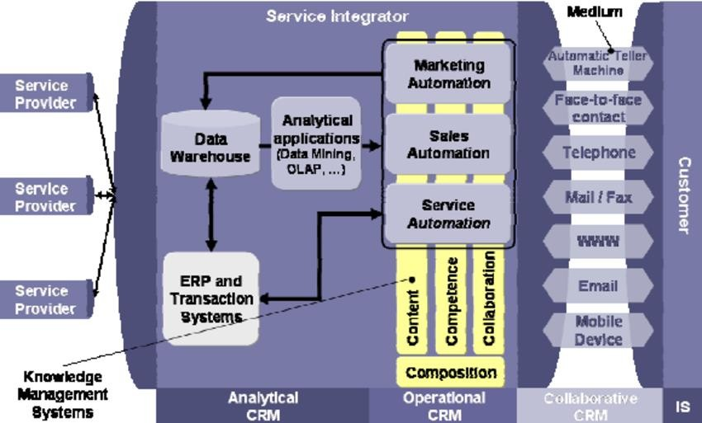
System Architecture

Slide 7
Architecture Explanation
This CRM system is using nested include generating the dynamic content web pages. The system is using the index.php to include header, content, and footer. Beside this, the system also using jquery ajax to display some data generated by the PHP inside the Widget folder
Platform Independence
The Write-Once-Run-Anywhere ideal has not been achieved (tuning for different platforms usually required), but closer than with other languages.
Object Oriented
Object oriented throughout - no coding outside of class definitions, including main(). An extensive class library available in the core language packages.

Slide 8
Compiler/Interpreter Combo
Code is compiled to bytecodes that are interpreted by a xampp compiler
This provides portability to any machine for which a virtual machine has been written.
The two steps of compilation and interpretation allow for extensive code checking and improved security.
Automatic Memory Management
Automatic garbage collection - memory management handled by database server .
No memory pointers
Programs runs inside the virtual machine sandbox.

Slide 9
Dynamic Binding
The linking of data and methods to where they are located, is done at run-time.
New classes can be loaded while a program is running. Linking is done on the fly.
Even if libraries are recompiled, there is no need to recompile code that uses classes.
Threading
Lightweight processes, called threads, can easily be spun off to perform multiprocessing.
Can take advantage of multiprocessors where available
Great for multimedia displays.
PHP was designed with networking in mind and comes with many classes to develop sophisticated Internet communications.

Slide 10
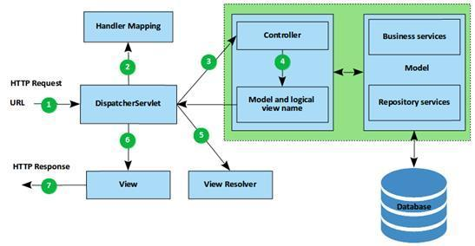
Sample Architecture

Slide 11
System Specification
HARDWARE SPECIFICATION
SYTEM : Computer and Server Internet Connection : Mobile Data or WIFI
RAM : 2 GB
SOFTWARE SPECIFICATION
Operating System : windows 7 or above
Language : HTML,PHP AND SQL
Run base of : XAMPP

Slide 12
Algorithm
THE SPRINT CLASSIFICATION OR HUNT"S ALGORITHM
1. It is fast scalable decision tree algorithm that can be implemented in serial and parallel pattern. It is based on HUNT'S Algorithm for decision tree classification.
2. It partitions a training data set recursively using the breadth-first greedy strategy that is integrated with the pre-sorting technique during the tree building phase.
3.It stands for Supervised Learning In Ques. It is a fast scalable decision tree algorithm that can be implemented in serial and parallel pattern.
4.It can be implemented in both serial and parallel pattern for good data placement and load balancingIt uses Minimum Description Length Principle(MDL) in pruning.

Slide 13
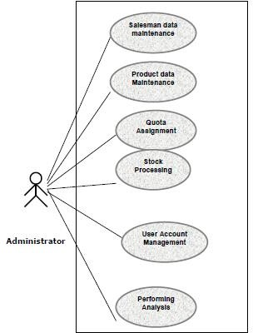
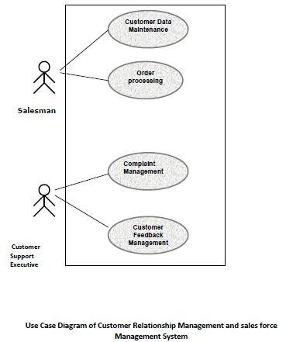
Use Case diagram for CRM
1)
2)

Slide 14
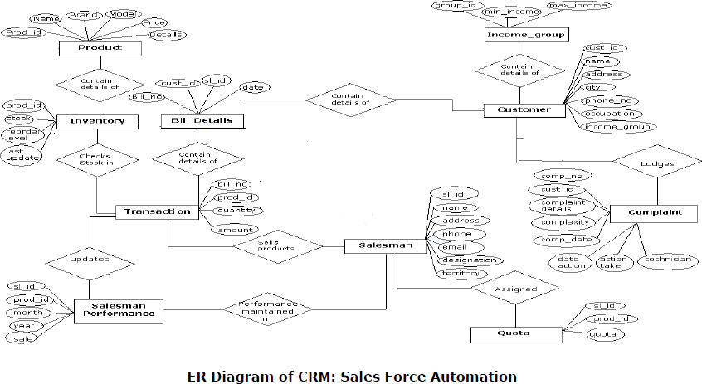
ENTITY RELATIONSHIP MODEL FOR
SALES FORCE USAGE

Slide 15
Types of testing used to test the
software for CRM
Black Box Testing
White Box Testing
White Box Testing
White box testing is a test case design approach that employs the control architecture of the procedural design to produce test cases. Using white box testing approaches, the software engineering can produce test cases that
Guarantee that all independent paths in a module have been exercised at least
Exercise all logical decisions
Execute all loops at their boundaries and in their operational bounds

Slide 16
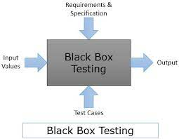
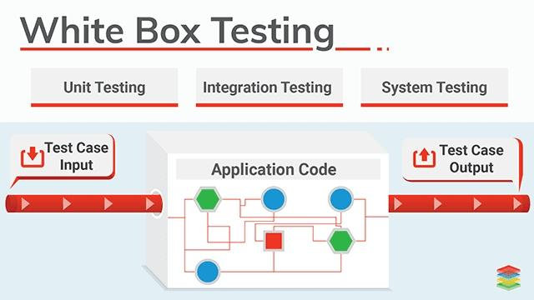
Black Box Testing
Black Box Testing is not a type of testing; it instead is a testing strategy, which does not need any knowledge of internal design or code etc. As the name "black box" suggests, no knowledge of internal logic or code structure is required. The types of testing under this strategy are totally based/focused on the testing for requirements and functionality of the work product/software application.

Slide 17
FUTURE SCOPE OF THE PROJECT
This application can be implement in those organizations where there is need for automation of sales work.
This application minimize manual work in the organization so work load on organization will decrease and efficiency and effectiveness of the organization will increase.
This application helps in reducing redundancy of the data and provides security so that unauthorized person cannot access the application.
The database management in the organization becomes more reliable. This application provide facility to analyze data of customer, sale and complains.
This can be highly useful in planning marketing and sales strategy of the organization.

Slide 18
CONCLUSION AND FUTURE ENHANCEMENT
There is always room for improving in any software package, however good efficient it may be. But the important thing is that the system should be flexible enough for future modification/ alteration whenever and by whomsoever it may be. Keeping in consideration this important factor, the system is designed in such a way. The software is developed in modules are efficient enough to introduce any change in the software to get more information.
Similarly, the present system can be implemented on Internet and software can be connected to the various branches of this home appliance company of course with more security constraints added to it

Slide 19
This project can be attached to website of the company which may provide information related to products and also provide facility of registering product etc. It may also help in finding new prospective customer.
The backend can be improved using Oracle; it will provide better database management and securities.
More modules can be added in the system such as it can provide facility of direct
email so that organization can generate offer letter and send it directly to the customer.

Slide 20
SOURCE CODE
<?php session_start();
include("dbconnection.php"); include("checklogin.php"); check_login();
?>
<!DOCTYPE html>
<html>
<head>
<meta http-equiv="content-type" content="text/html;charset=UTF-8" />
<meta charset="utf-8" />
<title>CRM | Admin Dashboard</title>
<meta name="viewport“ content="width=device-width,initial-scale=1.0,maximum- scale=1.0, user-scalable=no" />
<meta content="" name="description" />
<meta content="" name="author" />
<link href="../assets/plugins/jquery-metrojs/MetroJs.min.css" rel="stylesheet" type="text/css" />
<link rel="stylesheet" type="text/css" href="../assets/plugins/shape-hover/css/demo.css"
/>

Slide 21
<link rel="stylesheet" type="text/css" href="../assets/plugins/shape- hover/css/component.css" />
<link rel="stylesheet" type="text/css" href="../assets/plugins/owl- carousel/owl.carousel.css" />
<link rel="stylesheet" type="text/css" href="../assets/plugins/owl-
carousel/owl.theme.css"
/>
<link href="../assets/plugins/pace/pace-theme-flash.css" rel="stylesheet" type="text/css" media="screen"/>
<link href="../assets/plugins/jquery-slider/css/jquery.sidr.light.css“ rel="stylesheet" type="text/css" media="screen"/>
<link rel="stylesheet" href="../assets/plugins/jquery-ricksaw-chart/css/rickshaw.css" type="text/css" media="screen" >
<link rel="stylesheet" href="../assets/plugins/Mapplic/mapplic/mapplic.css" type="text/css" media="screen" >
<link href="../assets/plugins/boostrapv3/css/bootstrap.min.css" rel="stylesheet" type="text/css"/>
<link href="../assets/plugins/boostrapv3/css/bootstrap-theme.min.css" rel="stylesheet" type="text/css"/>
<link href="../assets/plugins/font-awesome/css/font-awesome.css" rel="stylesheet" type="text/css"/>

Slide 22
<link href="../assets/css/animate.min.css" rel="stylesheet" type="text/css"/>
<link href="../assets/plugins/jquery-scrollbar/jquery.scrollbar.css" rel="stylesheet" type="text/css"/>
<link href="../assets/css/style.css" rel="stylesheet" type="text/css"/>
<link href="../assets/css/responsive.css" rel="stylesheet" type="text/css"/>
<link href="../assets/css/custom-icon-set.css" rel="stylesheet" type="text/css"/>
<link href="../assets/css/magic_space.css" rel="stylesheet" type="text/css"/>
<link href="../css/bootstrap.min.css" rel="stylesheet">
<link href="../css/plugins/morris.css" rel="stylesheet">
<script type="text/javascript"
src="http://ajax.googleapis.com/ajax/libs/jquery/1.8.2/jquery.min.js"></script>
</head>
<body class="">
<?php include("header.php");?>
<div class="page-container row">
<?php include("leftbar.php");?>
<div class="clearfix"></div>
<!-- END SIDEBAR MENU -->
</div>
</div>
<!-- BEGIN PAGE CONTAINER-->
<div class="page-content">

Slide 23
<!-- BEGIN SAMPLE PORTLET CONFIGURATION MODAL FORM-->
<div id="portlet-config" class="modal hide">
<div class="modal-header">
<button data-dismiss="modal" class="close" type="button"></button>
<h3>Widget Settings</h3>
</div>
<div class="modal-body"> Widget settings form goes here </div>
</div>
<div class="clearfix"></div>
<div class="content sm-gutter">
<div class="page-title">
</div>
<!-- BEGIN DASHBOARD TILES -->
<div class="row">
<div class="col-md-3 col-vlg-3 col-sm-6">
<div class="tiles green m-b-10">
<div class="tiles-body">
<div class="controller"> <a href="javascript:;" class="reload"></a> <a href="javascript:;" class="remove"></a> </div>
<div class="tiles-title text-black">Overall Visitors </div>
<div class="widget-stats">
<div class="wrapper transparent">
<?php $ov=mysqli_query($con,"select * from usercheck");
$num=mysqli_num_rows($ov); ?>

Slide 24
<span class="item-title">Overall Visitors</span> <span class="item-count animate- number semi-bold" data-value="<?php echo $num;?>" data-animation- duration="700">0</span>
</div>
</div>
<div class="widget-stats ">
<div class="wrapper last">
<?php
$tdate=date("Y/m/d");
$tv1=mysqli_query($con,"select * from usercheck where logindate='$tdate'");
$num11=mysqli_num_rows($tv1); ?>
<span class="item-title">Today</span> <span class="item-count animate-number semi- bold" data-value=" <?php echo $num11;?>" data-animation-duration="700">0
</span>
?php>
</div>
</div>
</div>
</div>
</div>
<div class="col-md-3 col-vlg-3 col-sm-6">
<div class="tiles blue m-b-10">
<div class="tiles-body">

Slide 25
<div class="controller"> <a href="javascript:;" class="reload"></a> <a href="javascript:;" class="remove"></a> </div>
<div class="tiles-title text-black">Registered Users </div>
<div class="widget-stats">
<div class="wrapper transparent">
<?php $rt=mysqli_query($con,"select * from user");
$rw=mysqli_num_rows($rt);?>
<span class="item-title">Registered Users</span> <span class="item-count animate- number semi-bold" data-value="<?php echo $rw;?>" data- animation- duration="700">0</span>
</div>
</div>
<div class="widget-stats ">
<div class="wrapper last">
<?php
$utd=date('Y-m-d');
$rt1=mysqli_query($con,"select * from user where posting_date='$utd'");
$rw1=mysqli_num_rows($rt1);?>
<span class="item-title">Today's</span> <span class="item-count animate-number semi-bold" data-value="<?php echo $rw1;?>" data-animation-duration="700">0</span>
</div>
</div>
</div>

Slide 26
</div>
</div>
<div class="col-md-4 col-vlg-3 col-sm-6">
<div class="tiles purple m-b-10">
<div class="tiles-body">
<div class="controller"> <a href="javascript:;" class="reload"></a>
<a href="javascript:;" class="remove"></a> </div>
<div class="tiles-title text-black">Quote Requests </div>
<div class="widget-stats">
<div class="wrapper transparent">
<?php
$qr=mysqli_query($con,"select * from prequest");
$oq=mysqli_num_rows($qr); ?>
<span class="item-title">Overall Quotes</span> <span class="item-count animate- number semi-bold" data-value="<?php echo $oq?>" data-animation- duration="700">0</span>
</div>
</div>
<div class="widget-stats">
<div class="wrapper transparent">
<?php
$qr1=mysqli_query($con,"select * from prequest where status='0'");
$oq1=mysqli_num_rows($qr1) ?>

Slide 27
<span class="item-title">New Quotes's</span> <span class="item-count animate- number semi-bold" data-value="<?php echo $oq1;?>" data-animation- duration="700">0</span>
</div>
</div>
<div class="widget-stats ">
<div class="wrapper last">
<?php
$qr2=mysqli_query($con,"select * from prequest where status='1'");
$oq2=mysqli_num_rows($qr2);
?>
<span class="item-title">In Progress</span> <span class="item-count animate-number semi-bold" data-value="<?php echo $oq2;?>" data-animation-duration="700">0</span>
</div>
</div>
</div>
</div>
</div>
<div class="row">
<div class="col-md-3 col-vlg-3 col-sm-6">
<div class="tiles red m-b-10">
<div class="tiles-body">

Slide 28
<div class="controller"> <a href="javascript:;" class="reload"></a> <a href="javascript:;" class="remove"></a> </div>
<div class="tiles-title text-black">Overall Tickets </div>
<div class="widget-stats">
<div class="wrapper transparent">
<?php $vt=mysqli_query($con,"select * from ticket");
$ovt=mysqli_num_rows($vt);
?>
<span class="item-title">All Tickets</span> <span class="item-count animate-number semi-bold" data-value="<?php echo $ovt;?>" data-animation-duration="700">0</span>
</div>
</div>
<div class="widget-stats ">
<div class="wrapper last">
<?php
$tdate=date("Y/m/d");
$otv=mysqli_query($con,"select * from ticket where status='Open'");
$otv1=mysqli_num_rows($otv);
?>

Slide 29
<span class="item-title">Pending Tickets</span> <span class="item-count animate- number semi-bold" data-value="<?php echo $otv1;?>" data-animation- duration="700">0</span> <?php
?>
</div>
</div>
</div>
</div>
</div>
</div>
</div>
<!-- END DASHBOARD TILES -->
<!-- START DASHBOARD CHART -->
<div class="col-lg-12" style="min-height:280px;">
<div class="panel panel-red">
<div class="panel-heading">
<h3 class="panel-title"><i class="fa fa-long-arrow-right"></i> All User Visit </h3>
<script type="text/javascript"> var visitorsCount = [];
var myCat =[];
</script>

Slide 30
< ?php
$totaldays = cal_days_in_month(CAL_GREGORIAN, date("m"), date("Y"));
$month_array=array(); for($i=1; $i<=$totaldays; $i++)
{
if(!array_key_exists($i,$month_array))
{
$key = ''; if($i<10)
{
$key = '0'.$i;
$month_array[$key] = 0;
}
else
{
$month_array[$i] = 0;
}
?>
<script var myKey = "Day " + '<?php echo $i; ?>';
myCat.push(myKey);
</script> type="text/javascript">
<?php
}
}

Slide 31
//print_r($month_array);
$results = mysqli_query($con,"SELECT logindate FROM usercheck");
//$f2=mysql_num_rows($a2);
if(mysqli_num_rows($results) >0)
{
while($row = mysqli_fetch_row($results))
{
$user_date = $row[0];
$dateArray = explode('/',$user_date);
$year = $dateArray[0];
$monthName = date("M", mktime(0, 0, 0, $dateArray[1], 10));
$currentMonth = date('m',mktime(0, 0, 0, $dateArray[1], 10));
// echo $monthName;
//$month = date("M", strtotime($user_date));
//echo $month;
//echo $month.'<br/>';
//$day = date('d',$dateArray));
if($year == date("Y") && $currentMonth == date("m"))
{
if(array_key_exists($dateArray[2],$month_array))

Slide 32
{
$month_array[$dateArray[2]] = $month_array[$dateArray[2]] + 1;
}
}
}
}
//print_r($month_array); foreach($month_array as $key=>$value)
{
?>
<script type="text/javascript"> visitorsCount.push(<?php echo $value;?>);
</script>
<?php
}
?>
<script type="text/javascript"> var d = new Date();
var month = new Array();
month[0] = "January";
month[1] = "February";
month[2] = "March";
month[3] = "April";
month[4] = "May";
month[5] = "June";
month[6] = "July";

Slide 33
month[7] = "August";
month[8] = "September";
month[9] = "October";
month[10] = "November";
month[11] = "December";
var n = month[d.getMonth()];
$(function () {
$('#container').highcharts({ title: {
text: 'Daily Visitors Chart of ' + n,
x: -20 //center
},
subtitle: { text: '', x: -20},
xAxis: { categories: myCat},
yAxis: { min:0, title: {
text: 'Visitors Count'},
plotLines: [{ value: 0,
width: 1,
color: '#808080'
}]
},
tooltip: { valueSuffix: ' Users' },
legend: { layout: 'vertical', align: 'right',
verticalAlign: 'middle', borderWidth: 0},

Slide 34
series: [{ name: 'visitorsCount', data: visitorsCount}]
});
});
</script>
<div id="container" style="min-width: 310px; height: 400px; margin:0 auto"></div>
</div>
<div class="panel-body">
<div id="morris-line-chart"> </div>
<div class="text-right">
<a href="#">View Details <i class="fa fa-arrow-circle-right"></i></a>
</div>
</div>
</div>
</div>
</div>

Slide 35
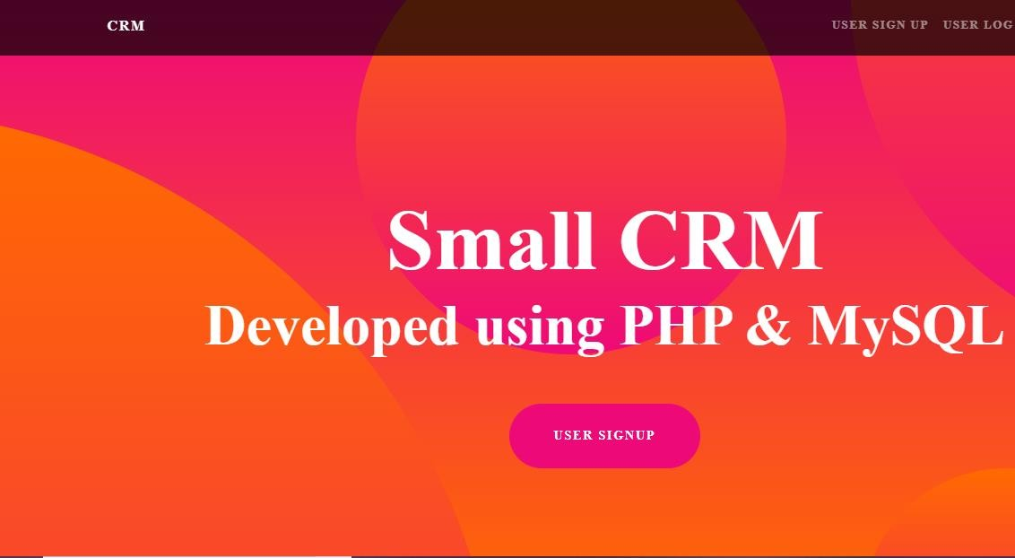
SNAPSHOTS OF PROJECT OUTPUT

Slide 36
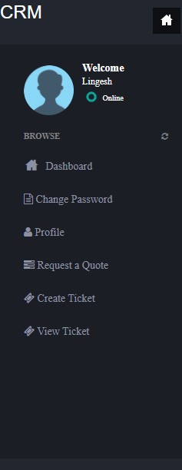
HOME PAGE OF WEBSITE

Slide 37
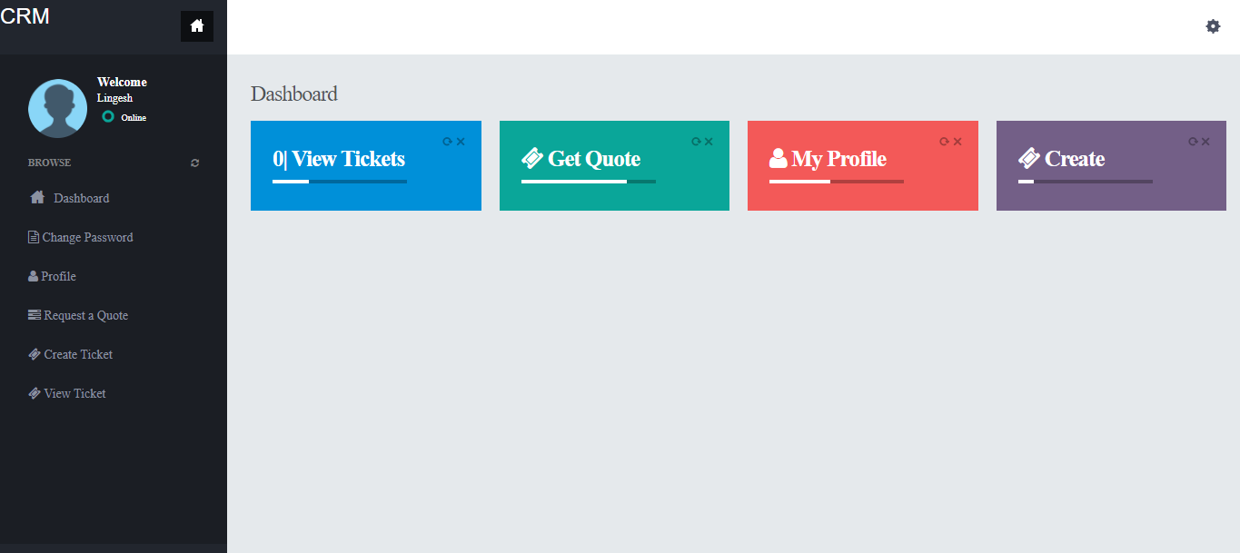
DASHBOARD OF WEBSITE

Slide 38
THANK YOU

